Slide 1
Art Festival
December 14th, 2018

Slide 2
Prints
You can make prints at Office Depot, Office Max, Kinkos and many other store and usually receive them on the same day.
For an 8x12 paper, depending on the finish you choose, it costs anywhere from $0.59 to $0.84. But you can go as big or small as you want.
You can print photos, paintings, sketchbook pages, anything really.
Personally, I fitted two images on one sheet of paper and then cut them out, making each cost around $0.30 each, and I sold them for five dollars
You can buy cheap mattes for about $1.00 and sell them for even more.

Slide 3
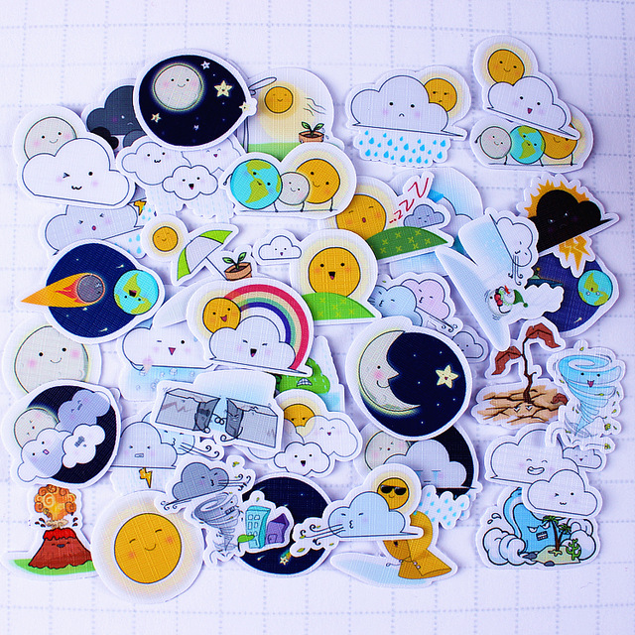
Stickers/ Tattoos
There’s no need to order them online, this is usually pretty costly.
You can buy sticker paper from Amazon or an Arts and Crafts store.
You print on them like it is a regular sheet of paper, just for the tattoos, on your computer, flip the designs.
Basically follow the instructions on the packet
On amazon you can buy 15 sheets for $5.41.

Slide 4
Other Items You could sell
T-shirts- you can buy t- shirt transfers at A.C. Moore, Michael’s…
Jewelry
Ceramics
Stationary
Actual paintings/ Drawings
Caricatures
Clothing
Written word
If you need inspiration, just go on Etsy and look at the types of things people are selling
(Just remember with whatever you sell, think about your audience and how much they would pay)

